Slide 1









Home
家
Home
VDO 16:9 Ratio
VDO 16:9 Ratio
7 Days Ago
Today
Your Advice Records
Friday 3, 2018 14:30
Soda สวัสดี 4 วินาที (ค่อยๆยกมือขึ้นมาพนม แล้วก้มหัวไหว้ช้าๆ ยกหัวขึ้น มือยังพนมไว้ หัวตรงแล้วค่อยวางแขนลง) และ ใช้ภาษามือบอกว่า สวัสดี และ how are you อาจจบท่าด้วยการชี้ไปที่คำถามที่พูดถามไปก็ได้ ใช้เวลา 5-10 วินาที
You ask for advice :
Total 456 case(s)
You give thanks to advisers :
Total 95 case(s)
Hi. How are you?
I feel good
I am OK
You give advice to people :
Total 75,833 case(s)
You receive thanks :
Total 999 case(s)
I am not OK
I feel bad

Slide 2
Home
家
Home
VDO 16:9 Ratio
VDO 16:9 Ratio
7 Days Ago
Today
อั้มทำเสร็จแล้ว
Finished
Your Advice Records
Friday 3, 2018 14:30
You ask for advice :
Total 456 case(s)
You give thanks to advisors :
Total 95 case(s)
Hi. How are you?
Share Lesson
Ask for Advice
Share Lesson
Ask for Advice
I feel good
I am OK
You give advice to people :
Total 75,833 case(s)
You receive thanks :
Total 999 case(s)
I am not OK
I feel bad

Slide 3
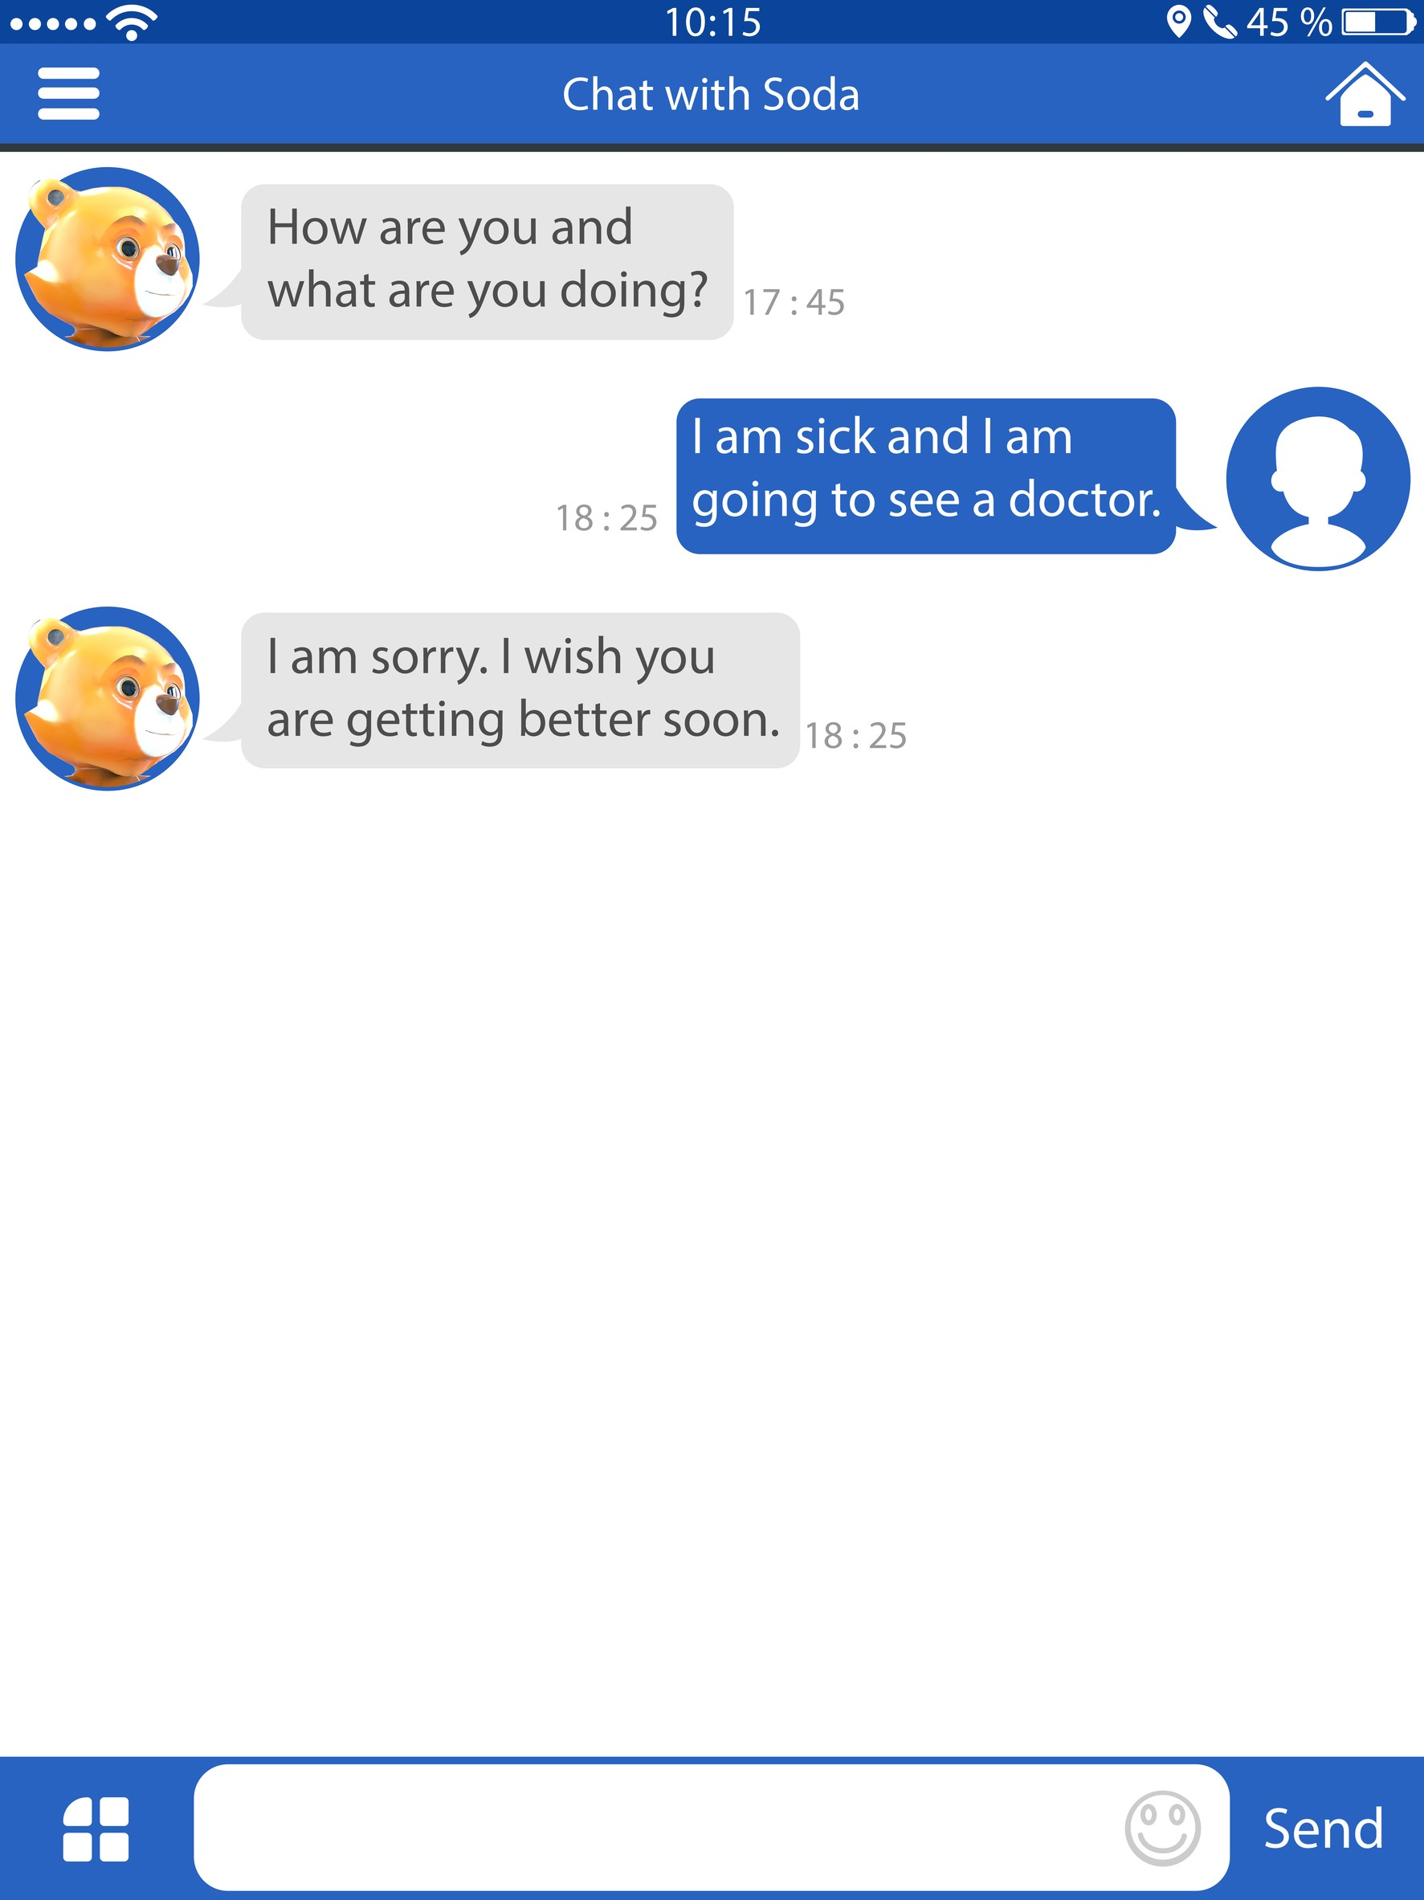


Chat with Soda
How are you and what are you doing?
17:45
I am sick and I am going to see a doctor.
18:25
I am sorry. I wish you are getting better soon.
18:25
Finished

Slide 4
Share Lesson & Story ?
Ask for Advice ?
7 Days Ago
Today
7 Days Ago
Today
It is good to be positive.
To help people to be positive, you may share lesson that you are OK.
Soda ทำท่าพูดคุยกับ user สัก 5-10 วินาที
It is not good to be negative.
I and other people would like to help you. You are not alone. Do you open for any advice?
Share Lesson
Ask for Advice
Sorry, maybe later
No, thank you.

Slide 5
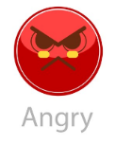







Ask for Advice
Ask for Advice
1. My Question & Unsolved Problem
5. My Status in Story
Max 250 Characters… (เผื่อไว้ 2 บรรทัด)
I feel good
I feel bad
I am OK
I am not OK
2. My Story in Brief
อั้มทำ icon emoji ให้เป็นแนวเดียวกันได้มั้ย เพราะมันจะเป็นเสมือนตัวแทนของ user น่ะ หน้าแสดงอารมณ์ต่างๆ น่าจะเป็นธีมเดียวกัน
6. My Feeling & Emotion in Story
Max 250 Characters… (เผื่อไว้ 2 บรรทัด)
3. My Full Story
Max 5,000 Characters… (เผื่อไว้ 5 บรรทัด)
4. Tag for My Story
Other Feeling and Emotion…
7. About Me in Story
Work, Boss, Unfair, Promotion, Process
Cancel
Send
Cancel
Send

Slide 6

Ask for Advice
Ask for Advice
Subject
Someone
Like
Verb
Hit/Hurt
I do not meet who or what I like; I am away from who or what I like
Object
L3
Me/Myself
Effect on Me
Property
L4
I meet or be with who or what I do not like
Physical Body
Mental State
Mindset
I am not OK
Acceptance
Social Status
Relationship
A3
I still can not mentally accept what happens
Way of Life
Finance
I am not OK
A4
I can not mentally accept my current status or situation
8. Root Cause of My Status
Want
W3
I do not get what I want; I get what I do not want
W4
I do not do what I want; I do what I do not want
Cancel
Send
Cancel
Send

Slide 7








Share Lesson
Share Lesson
1. My Lesson
5. My Status in Story
Max 250 Characters… (เผื่อไว้ 2 บรรทัด)
I feel good
I feel bad
I am OK
I am not OK
2. My Story in Brief
6. My Feeling & Emotion in Story
Max 250 Characters… (เผื่อไว้ 2 บรรทัด)
3. My Full Story
Pleased
Max 5,000 Characters… (เผื่อไว้ 5 บรรทัด)
Inspired
4. Tag for My Story
Other Feeling and Emotion…
7. About Me in Story
Work, Boss, Unfair, Promotion, Process
Cancel
Send
Cancel
Send

Slide 8
Share Lesson
Share Lesson
Subject
Someone
Like
Verb
Hit/Hurt
L1
I meet or be with who or what I like
Object
Me/Myself
Effect on Me
I do not meet who or what I do not like; I am away from who or what I do not like
Physical Body
Property
L2
Mental State
Mindset
I am not OK
Acceptance
Social Status
Relationship
A1
I can mentally accept what happens
Way of Life
Finance
I am not OK
A2
I can mentally accept my current status or situation
8. Root Cause of My Status
Want
W1
I get what I want; I do not get what I do not want
W2
I do what I want; I do not do what I do not want
Cancel
Send
Cancel
Send

Slide 9
Waiting for Advice
Waiting for Advice
Should I tell my boss that his evaluation is not acceptable to me? Should I tell my boss that his evaluation is not XXXXXXXXXXXXXX? Should I tell my boss that his evaluation is not acceptable to me? Should I tell him his evaluation is not acceptable?
My boss evaluates my performance unfairly. I do not get promotion as I should. My boss evaluates my performance unfairly. I do not get promotion as I should. My boss evaluates my performance unfairly. I do not get promotion as I should. What to do???
Got 2 advice
Should I tell my boss that his evaluation is not acceptable to me? Should I tell my boss that his evaluation is not XXXXXXXXXXXXXX? Should I tell my boss that his evaluation is not acceptable to me? Should I tell him his evaluation is not acceptable?
My boss evaluates my performance unfairly. I do not get promotion as I should. My boss evaluates my performance unfairly. I do not get promotion as I should. My boss evaluates my performance unfairly. I do not get promotion as I should. What to do???
Asked 20 mins ago; Got 10 advice; Gave 3 special thanks to adviser(s)
Should I tell my boss that his evaluation is not acceptable to me?
My boss evaluates my performance unfairly. I do not get promotion as I should.
Got 1 advice
Should I tell my boss that his evaluation is not acceptable to me?
My boss evaluates my performance unfairly. I do not get promotion as I should.
Asked 20 mins ago; Got 10 advice; I gave advice and got special thanks
Should I tell my boss that his evaluation is not acceptable to me?
My boss evaluates my performance unfairly. I

Slide 10
Lesson
Lesson
Should I tell my boss that his evaluation is not acceptable to me? Should I tell my boss that his evaluation is not XXXXXXXXXXXXXX? Should I tell my boss that his evaluation is not acceptable to me? Should I tell him his evaluation is not acceptable?
My boss evaluates my performance unfairly. I do not get promotion as I should. My boss evaluates my performance unfairly. I do not get promotion as I should. My boss evaluates my performance unfairly. I do not get promotion as I should. What to do???
Got 10 comment(s) and 5 like(s)
Should I tell my boss that his evaluation is not acceptable to me? Should I tell my boss that his evaluation is not XXXXXXXXXXXXXX? Should I tell my boss that his evaluation is not acceptable to me? Should I tell him his evaluation is not acceptable?
My boss evaluates my performance unfairly. I do not get promotion as I should. My boss evaluates my performance unfairly. I do not get promotion as I should. My boss evaluates my performance unfairly. I do not get promotion as I should. What to do???
Shared 20 mins ago; Got 10 comment(s) and 5 like(s); Gave 3 special thanks to commenter(s)
Should I tell my boss that his evaluation is not acceptable to me?
My boss evaluates my performance unfairly. I do not get promotion as I should.
Got 10 comment(s) and 5 like(s)
Should I tell my boss that his evaluation is not acceptable to me?
My boss evaluates my performance unfairly. I do not get promotion as I should.
Got 10 comment(s) and 5 like(s); I commented; I liked it
Should I tell my boss that his evaluation is not acceptable to me?
My boss evaluates my performance unfairly.

Slide 11

Ask for Advice
Asked by XGQ89009090A
Should I tell my boss that his evaluation is not acceptable to me? Should I tell my boss that his evaluation is not XXXXXXXXXXXXXX? Should I tell my boss that his evaluation is not acceptable to me? Should I tell him his evaluation is not acceptable?
My boss evaluates my performance unfairly. I do not get promotion as I should. My boss evaluates my performance unfairly. I do not get promotion as I should. My boss evaluates my performance unfairly. I do not get promotion as I should. What to do???
See 2 advice
See full story
Tag: Work, Boss, Unfair, Promotion, Process
Self Assessment
Write comment
Send

Slide 12
Ask for Advice
Ask for Advice
Asked by XGQ89009090A
Full Story
Should I tell my boss that his evaluation is not acceptable to me? Should I tell my boss that his evaluation is not XXXXXXXXXXXXXX? Should I tell my boss that his evaluation is not acceptable to me? Should I tell him his evaluation is not acceptable?
My boss evaluates my performance unfairly. I do not get promotion as I should. My boss evaluates my performance unfairly. I do not get promotion as I should. My boss evaluates my performance unfairly. I do not get promotion as I should. What to do???
See 2 advice
See full story
Tag: Work, Boss, Unfair, Promotion, Process
Self Assessment
Write comment
Send
Write comment
Send

Slide 13


Ask for Advice
Ask for Advice
Asked by XGQ89009090A
Advice
Only Unread
get promotion as I should. My boss evaluates my performance unfairly. I do not get promotion as I should. What to do???
See 2 advice
Report
#1 by AAABBBCCC789
Surefire Ways Not to Get Promoted
1. Don't plan your day. Go to work each day without a plan in mind.
2. Do the minimum. Have the attitude of “they don't pay me for that.”
3. Rely on your current base of knowledge. No need to learn new skills.
4. Voice your complaints. ...
5. Don't share the credit.
See full story
Tag: Work, Boss, Unfair, Promotion, Process
Self Assessment
Status:
I am not OK
I am sad
Common Sense:
Someone help me
Effect on my physical body, mental state, social status, way of life
Root cause of Status:
I do not do what I want; I do what I do not want (RC#W4)
Report
#2 by QQQBBBCCC456
Surefire Ways Not to Get Promoted
1. Don't plan your day. Go to work each day without a plan in mind.
2. Do the minimum. Have the attitude
Write comment
Send
Write comment
Send

Slide 14
Ask for Advice
Ask for Advice
Asked by XGQ89009090A
Advice
Show all 10 advice
Only Unread
Asked 20 mins ago
Got 10 advice
Gave 3 special thanks to adviser(s)
Delete
#1 by AAABBBCCC789
Surefire Ways Not to Get Promoted
1. Don't plan your day. Go to work each day without a plan in mind.
2. Do the minimum. Have the attitude of “they don't pay me for that.”
3. Rely on your current base of knowledge. No need to learn new skills.
4. Voice your complaints. ...
5. Don't share the credit.
Thanks
Show 3 advice that got special thanks
See full story
Tag: Work, Boss, Unfair, Promotion, Process
Self Assessment
Status:
I am not OK
I am sad
Common Sense:
Someone help me
Effect on my physical body, mental state, social status, way of life
Root cause of Status:
I do not do what I want; I do what I do not want (RC#W4)
Thanks
Delete
#2 by QQQBBBCCC456
Surefire Ways Not to Get Promoted
1. Don't plan your day. Go to work each day without a plan in mind.
2. Do the minimum. Have the attitude
Write comment
Send
Write comment
Send

Slide 15
Share Lesson
Shared by XGQ89009090A
Like
Should I tell my boss that his evaluation is not acceptable to me? Should I tell my boss that his evaluation is not XXXXXXXXXXXXXX? Should I tell my boss that his evaluation is not acceptable to me? Should I tell him his evaluation is not acceptable?
My boss evaluates my performance unfairly. I do not get promotion as I should. My boss evaluates my performance unfairly. I do not get promotion as I should. My boss evaluates my performance unfairly. I do not get promotion as I should. What to do???
Got 5 Like(s)
See 10 comment(s)
See full story
Tag: Work, Boss, Unfair, Promotion, Process
Self Assessment
Write comment
Send

Slide 16
Share Lesson
Share Lesson
Shared by XGQ89009090A
Full Story
Unlike
Should I tell my boss that his evaluation is not acceptable to me? Should I tell my boss that his evaluation is not XXXXXXXXXXXXXX? Should I tell my boss that his evaluation is not acceptable to me? Should I tell him his evaluation is not acceptable?
My boss evaluates my performance unfairly. I do not get promotion as I should. My boss evaluates my performance unfairly. I do not get promotion as I should. My boss evaluates my performance unfairly. I do not get promotion as I should. What to do???
Got 5 Like(s)
See 10 comment(s)
See full story
Tag: Work, Boss, Unfair, Promotion, Process
Self Assessment
Write comment
Send
Write comment
Send

Slide 17
Share Lesson
Share Lesson
Shared by XGQ89009090A
Comment
Like
Only Unread
my performance unfairly. I do not get promotion as I should. What to do???
Got 5 Like(s)
See 10 comment(s)
Report
#1 by AAABBBCCC789
Surefire Ways Not to Get Promoted
1. Don't plan your day. Go to work each day without a plan in mind.
2. Do the minimum. Have the attitude of “they don't pay me for that.”
3. Rely on your current base of knowledge. No need to learn new skills.
4. Voice your complaints. ...
5. Don't share the credit.
See full story
Tag: Work, Boss, Unfair, Promotion, Process
Self Assessment
Status:
I am not OK
-
Common Sense:
-
-
Root cause of Status:
-
Report
#2 by QQQBBBCCC456
Surefire Ways Not to Get Promoted
1. Don't plan your day. Go to work each day without a plan in mind.
2. Do the minimum. Have the attitude
Write comment
Send
Write comment
Send

Slide 18
Share Lesson
Share Lesson
Shared by XGQ89009090A
Comment
Show all 10 comments
Only Unread
Shared 20 mins ago; Got 5 likes(s)
See 10 comment(s)
Gave 3 special thanks to commenter(s)
Delete
#1 by AAABBBCCC789
Surefire Ways Not to Get Promoted
1. Don't plan your day. Go to work each day without a plan in mind.
2. Do the minimum. Have the attitude of “they don't pay me for that.”
3. Rely on your current base of knowledge. No need to learn new skills.
4. Voice your complaints. ...
5. Don't share the credit.
Thanks
Show 3 comments that got special thanks
See full story
Tag: Work, Boss, Unfair, Promotion, Process
Self Assessment
Status:
I am not OK
I am sad
Common Sense:
Someone help me
Effect on my physical body, mental state, social status, way of life
Root cause of Status:
I do not do what I want; I do what I do not want (RC#W4)
Thanks
Delete
#2 by QQQBBBCCC456
Surefire Ways Not to Get Promoted
1. Don't plan your day. Go to work each day without a plan in mind.
2. Do the minimum. Have the attitude
Write comment
Send
Write comment
Send

Slide 19







Message
…Current Page…
Advice & Comment
Call it as
“G Coin”
Only Unread
G
My ID: XGQ89009090A
Q#145987 2018-02-12 22:45
G
123,456,789
Delete
#1 by AAABBBCCC789
Surefire Ways Not to Get Promoted
1. Don't plan your day. Go to work each day without a plan in mind.
2. Do the minimum. Have the attitude of “they don't pay me for that.”
3. Rely on your current base of knowledge. No need to learn new skills.
4. Voice your complaints. ...
5. Don't share the credit.
Thanks
Coin Named Good Dollar
My Activities
Ask for Advice (123,456,789)
Give Advice (987,654,321)
Share Lesson (123,456,789)
Give Comment (987,654,321)
G
Befriend with Soda
Give Food (123,456,789)
Give Thing (987,654,321)
L#2665989 2018-02-12 22:45
Use this Gold color for the coin
My Account
Account Info
Setting
Tutorial & Help
About Us
Thanks
Delete
#2 by QQQBBBCCC456
Surefire Ways Not to Get Promoted
1. Don't plan your day. Go to work each day without a plan in mind.

Slide 20




ฉากในการให้ของกินกับ Soda
1.มีมือยื่นของกินออกไป Soda ก็รับแล้ววางบนโต๊ะ แล้วตักขึ้นมากิน
2.โฟกัสไปที่หน้า Soda กำลังเคี้ยว แสดงสีหน้าที่มีความสุขกับการกิน สดชื่น อาจแสดงท่ากินสัก 10 วินาที
3.ถ้ามีเครื่องดื่มให้ ก็แสดงท่าดูดน้ำ(เห็นแค่หลอดก็ได้)สัก 4-5 วินาที
4.เช็ดปาก
5.ไหว้ขอบคุณ ตามด้วยภาษามือว่า ขอบคุณ (Thank you)
Give Food to Soda
Meal Set
Dish
Desert
Drink
Give Food to Soda
Give Thing to Soda
Salad
Steak
Mixed Vegetable
8
10
10
Food = 10 items; Price = 25 G-Dollar
Buy

Slide 21
Give Thing to Soda
Apparel
Equipment
Furniture
Others
Give Food to Soda
Give Thing to Soda
Thing = 1 items; Price = 15 G-Dollar
Buy

Slide 22
Message
Share Lesson & Story

